Slide 1
FAIR USE NOTICE
The material used in this presentation i.e., pictures/graphs/text, etc. is solely intended for educational/teaching purpose, offered free of cost to the students for use under special circumstances of Online Education due to COVID-19 Lockdown situation and may include copyrighted material - the use of which may not have been specifically authorised by Copyright Owners. Its application constitutes Fair Use of any such copyrighted material as provided in globally accepted law of many countries. The contents of presentations are intended only for the attendees of the class being conducted by the presenter.

Slide 2
CLOUD COMPUTING

Slide 3
XML
Stands for the extensible mArkup Language.
A markup language is the one that is based on the tags and sub tags and the value associated with those tags such as the HTML etc, but XML is unlike them the Markup Language which is extensible in nature i.e. it can be used to define the other markup languages.
It allows designers to create their own customized tags, enabling the definition, transmission, validation, and interpretation of data between applications and between organizations.

Slide 4
Introduced by World wide web consortium, W3C, in 1994 as a subset of SGML.
XML was designed to describe data.
XML is a software- and hardware-independent tool for carrying information.
XML is easy to learn.
XML- the extensible Markup Language- is the meta-language- a language for defining other languages.
XML defines the rules for creating XML markup languages.
An XML markup defines a set of tags that are used to organize and describe the text. The tags are usually paired, as start tag and end tag

Slide 5
XML documents are composed of Unicode text (usually UTF-8), so people as well as software can understand them.
XML is used for two different purposes: document-oriented and data-oriented applications.
Document-oriented markup languages are focused on the format and presentation of literature. They describe how books, magazines, and business and scientific papers are organized, and how they look.
Data-oriented markup languages focus on how data is organized and typed; they define a schema for storing and exchanging data between software applications.
Notes:
XHTML – application of XML
5

Slide 6
Some XML markup languages are industry standards, like SOAP and XHTML, while most are designed to serve a single application, organization, or individual.

Slide 7
XML Does Not DO Anything
The following example is a note to Ahmed, from Ali, stored as XML:
<note> <to>Ahmed</to> <from>Ali</from> <heading>Reminder</heading> <body>Don't forget me this weekend!</body> </note>
The note above is quite self descriptive.
But still, this XML document does not DO anything. It is just information wrapped in tags. Someone must write a piece of software to send, receive or display it.

Slide 8
Difference between XML and HTML
XML and HTML were designed with different goals:
XML was designed to transport and store data, with focus on what data is
HTML was designed to display data, with focus on how data looks
HTML is about displaying information, while XML is about carrying information.

Slide 9
WELL-FORMED XML:
“Well-formed XML is an XML document that meets the certain grammatical rules outlined in the XML 1.0 specification.”:
Example of a simple XML document:
<?xml version=“1.0” ?>
<name>
<f-name> Muhammad </f-name>
<middle> Ali </middle>
<l-name> Jinnah </l-name>
</name>

Slide 10
10
Syntax Rules
All elements must have a closing tag: E.g. <Name> Ali </Name>
The tags are case sensitive: <name> Ahmed </name>
Elements must be properly nested
<b><i>This text is bold and italic</b></i> X
<b><i>This text is bold and italic</i></b> √
Documents must have a root element
XML Attribute Values Must be Quoted: e.g. <note date="12/11/2007">
ENTITY REFERENCES: Some characters have a special meaning.
<message>if salary < 1000 then</message>
Use entity reference to avoid error

Slide 11
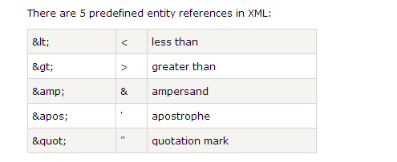

Slide 12
XML Naming Rules
XML elements must follow these naming rules:
Names can contain letters, numbers, and other characters
Names cannot start with a number or punctuation character
Names cannot start with the letters xml (or XML, or Xml, etc)
Names cannot contain spaces
Any name can be used, no words are reserved.

Slide 13
The text between start and end tags is known as the element contents, which is also called as the Parse Character Data or PCDATA.
Not only this but the XML can be used to model any complex type of data as possible.

Slide 14
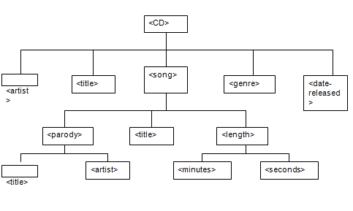
As an example we can model the data related to a CD of songs as shown in following
Notes:
14

Slide 15
<CD>
<artist>Weird Al Yankovic </artist>
<title> Take me to your heart </title>
<genre>parady </genre>
<date-released>10/04/2005</date-released>
<song>
<title> Like a Surgeon </title>
<length>
<minutes> 3 </minutes>
<seconds>35</seconds>
</length>
<parody>
<title>Like a virgin</title>
<artist>Madona</artist>
</parody>
</song>
<song>
<title>Dare to be Stupod </title>
<length>
<minutes>4 </minutes>
<seconds> 30</seconds>
</length>
<parody/>
</song>
</CD>

Slide 16
Anatomy of an XML Document
An XML document is made up of declarations, elements, attributes, text data, comments, and other components.
1. Declaration:
An XML document starts with an XML declaration. It declares the XML version, and encoding type
2. Elements:
XML markup languages organize data hierarchically, in a tree structure with the help of the elements.
The top most element called the root element, defines the type of the XML document.
The content of the element is known as the PC DATA.

Slide 17
ATTRIBUTES:
An element may have one or more attributes.
To supplement the data contained by an element, to provide information about it not captured by its contents.
For example, we could describe the kind of address in an XML address document by declaring a genre attribute as in example in the next slide.,

Slide 18
Using Attributes in Address Book Markup:
<?xml version="1.0" encoding="UTF-8”>
<address genre="business" >
<name>Amazon.com</name>
<street>1516 2nd Ave</street>
<city>Seattle</city>
<state>WA</state>
<zip>90952</zip>
</address>

Slide 19
Using Empty Elements:
In many cases, empty-element tags are used when the attributes contain all the data.
E.g. we could add an empty phone element to the XML address document .
Listing 2-4 Using the Empty-Element Tag in XML
<?xml version="1.0" encoding="UTF-8" ?>
<address genre="business" > <name>Amazon.com</name>
<street>1516 2nd Ave</street>
<city>Seattle</city>
<state>WA</state>
<zip>90952</zip>
<phone countrycode="01" areacode="715" number="55529482" ext="341" />
</address>
Using attributes instead of nested elements is considered a matter of style, rather than convention. There are no "standard" design conventions for using attributes or elements.

Slide 20
Comments:
Comments are placed between a <!-- designator and a --> designator.
CDATA Section:
Is used to insert the XML special characters such as the <, >, “, @ , ampersand & or / etc symbols in the PC DATA of the element contents which may confuse parsers.
To avoid such parsing problems you can use escape characters like &gt for greater-than or &amp for ampersand, but this technique can become cumbersome.
A CDATA section allows you to mark a section of text as literal so that it will not be parsed for tags and symbols, but will instead be considered just a string of characters.
For example, if you want to put HTML in an XML document, but you don't want it parsed.

Slide 21
Using a CDATA Section in XML
<?xml version="1.0" encoding="UTF-8" ?>
<!-- This document contains address information -->
<address genre="business" >
<name>Amazon.com</name>
<street>1516 2nd Ave</street>
<city>Seattle</city>
<state>WA</state>
<zip>90952</zip>
<note>
<![CDATA[ <html> <body> <p> Last time I contacted <b>Amazon.com</b> I spoke to ... </body> </html> ]]> </note>
</address>

Slide 22
XML ELEMENTS VS. ATTRIBUTES
<person gender="female">
<firstname>Anna</firstname>
<lastname>Smith</lastname>
</person>
Both examples provide the same information.
<person>
<gender>female</gender>
<firstname>Anna</firstname>
<lastname>Smith</lastname>
</person>

Slide 23
Valid XML
Besides the well-formed XML documents (which confirms the correct XML syntax), sometimes XML documents need to dictate certain rules.
These rules may be the which documents contains what elements, in what sequence and what may be the possible content value of those elements etc.
The documents which confirms to such rules are known as the Valid XML documents:
There are different ways to defines such rules: The famous are two: DTD (Document Type Definition) and the XML Schema.
The XML specification includes the Document Type Definition (DTD), which can be used to describe XML markup languages and to validate instances of them (XML documents).

Slide 24
DTD
A Document Type Definition (DTD) defines the legal building blocks of an XML document.
It defines the document structure with a list of legal elements and attributes.
A DTD can be declared inline inside an XML document, or as an external reference

Slide 25
VALID XML DOCUMENTS
A "Valid" XML document is a "Well Formed" XML document, which also conforms to the rules of a Document Type Definition (DTD)

Slide 26
Internal DTD
<?xml version="1.0"?>
<!DOCTYPE note[
<!ELEMENT note (to,from,heading,body)>
<!ELEMENT to (#PCDATA)>
<!ELEMENT from (#PCDATA)>
<!ELEMENT heading (#PCDATA)>
<!ELEMENT body (#PCDATA)>
]>
<note type=“personal”> <to>Tom</to> <from>Joey</from> <heading>Reminder</heading> <body>Don't forget me this weekend!</body>
</note>

Slide 27
External DTD
<?xml version="1.0" encoding="ISO-8859-1"?>
<!DOCTYPE note SYSTEM "Note.dtd">
<note>
<to>Tom</to>
<from>Joey</from>
<heading>Reminder</heading>
<body>Don't forget me this weekend!</body>
</note>

Slide 28
Note.dtd
<!ELEMENT note (to,from,heading,body)>
<!ELEMENT to (#PCDATA)>
<!ELEMENT from (#PCDATA)>
<!ELEMENT heading (#PCDATA)>
<!ELEMENT body (#PCDATA)>

Slide 29
XML Name Spaces
An XML namespace provides a qualified name for an XML element or attribute, the same way that a Java package provides a qualified name for a Java class.
Java package names allow us to separate Java classes into distinct namespaces, which improves organization and access control, and helps us avoid name conflicts (collisions).
XML namespaces are similar to Java packages, and serve the same purposes; an XML namespace provides a kind of package name for individual elements and attributes.

Slide 30
AN EXAMPLE OF USING NAMESPACES
Creating XML documents based on multiple markup languages is often desirable.
For example, suppose we are building a billing and inventory control system for a company called Monson-Haefel Books.
For defining the addresses we have defined the Address Book Markup Language, whose instance is shown in above example:
Address Markup has its own schema, defined using either DTD or W3C XML Schema Language, which dictates how its elements are organized.
Every time we use address information in an XML document, it should be validated against Address Markup's schema. For example, in example 1 the address information is included in the PurchaseOrder XML document.

Slide 31
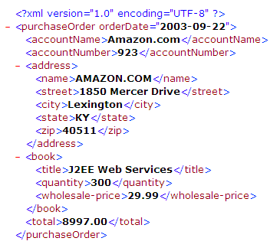
Example 1
The PurchaseOrder Document Using the Address Markup Language

Slide 32
If the purchase-order document has its own schema (defined by the Purchase Order Markup Language) and the address information has its own schema (defined by the Address Markup Language), how do we indicate that the address element should conform to the Address Markup Language, while the rest of the elements conform to the Purchase Order Markup Language? We use namespaces.
We can state that the address elements conform to Address Markup by declaring the namespace of Address Markup in the address element. We can do the same thing for the purchase order elements by declaring, in the purchaseOrder element, that they conform to the Purchase Order Markup. Example 2 illustrates.

Slide 33
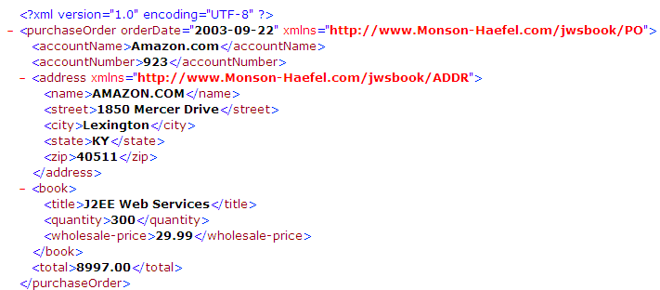
Example2 :Declaring Namespaces in XML
The xmlns attribute declares a specific XML namespace in the form xmlns="someURI".

Slide 34
Default Namespaces, Prefixes, and Qualified Names
The xmlns declarations made in example3 defined the default namespace for the element and all its descendants.
The scope of a default namespace applies only to the element and its descendants, so the xmlns used in the address element applies only to the address, name, street, city, state, and zip elements.
The default xmlns declared in the purchaseOrder element applies to all the elements except the address elements, because the address element overrides the default namespace of the purchaseOrder element to define its own default namespace.
To simplify things, XML Namespaces defines a shorthand notation for associating elements and attributes with namespaces. You can assign an XML namespace to a prefix, then use that prefix to fully qualify each element name.
The code in example3 assigns the prefix "addr:" to the http://www.Monson-Haefel.com/jwsbook/ADDR namespace and the prefix "po:" to the http://www.Monson-Haefel.com/jwsbook/PO namespace, then uses one prefix or the other to qualify each element.

Slide 35
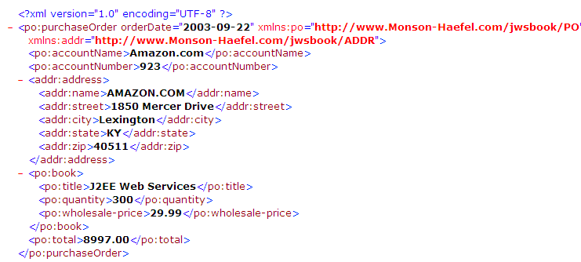
Declaring and Using Namespaces Prefixes in XML
The elements prefixed with addr: belong to the http://www.Monson-Haefel.com/jwsbook/ADDR namespace and the elements prefixed with po: belong to the http://www.Monson-Haefel. com/jwsbook/ Purchase Order namespace.

Slide 36
XML Schema
XML Schema is an XML-based alternative to DTD.
An XML schema describes the structure of an XML document.
The XML Schema language is also referred to as XML Schema Definition (XSD).
While DTDs have proven very useful over the years, they are also limited. To address limitations of DTDs, the W3C (World Wide Web Consortium), which manages the fundamental XML standards, created a new way to describe markup languages called XML schema.

Slide 37
Why XML Schema Is Preferred to DTDs in Web Services:
DTDs have done an adequate job of telling us how elements and attributes are organized in a markup language, but they fail to address data typing
XML schema, by contrast, provides a much stronger type system. Many believe that XML schema is superior to DTD because it defines a richer type system, which includes simple primitives (integer, double, boolean, among others) as well as facilities for more complex types. XML schema facilitates type inheritance, which allows simple or complex types to be extended or restricted to create new types.
In addition, XML schema supports the use of XML namespaces to create compound documents composed of multiple markup languages.

Slide 38
An XML Schema:
defines elements that can appear in a document
defines attributes that can appear in a document
defines which elements are child elements
defines the order of child elements
defines the number of child elements
defines whether an element is empty or can include text
defines data types for elements and attributes
defines default and fixed values for elements and attributes

Slide 39
XML Replacing DTDs:
Here are some reasons:
XML Schemas are richer and more powerful than DTDs
XML Schemas are written in XML
XML Schemas support data types
XML Schemas support namespaces

Slide 40
A simple XML document:
?xml version="1.0"?> <note> <to>Ahmed</to> <from>Ali</from> <heading>Reminder</heading> <body>Don't forget me this weekend!</body> </note>
It’s DTD:
<!ELEMENT note (to, from, heading, body)> <!ELEMENT to (#PCDATA)> <!ELEMENT from (#PCDATA)> <!ELEMENT heading (#PCDATA)> <!ELEMENT body (#PCDATA)>

Slide 41
Schema (.xsd file format)
<?xml version="1.0"?> <xs:schema xmlns:xs="http://www.w3.org/2001/XMLSchema"> <xs:element name="note“ type=“mytype”/> <xs:complexType name=“mytype”> <xs:sequence> <xs:element name="to" type="xs:string"/> <xs:element name="from" type="xs:string"/> <xs:element name="heading" type="xs:string"/> <xs:element name="body" type="xs:string"/> </xs:sequence> </xs:complexType> </xs:schema>

Slide 42
Reference to XML Schema
DTD is refered as follows:
<!DOCTYPE note SYSTEM "https://www.w3schools.com/xml/note.dtd">
This XML document has a reference to an XML Schema:
<?xml version="1.0"?> <note xmlns="http://www.w3schools.com" xmlns:xsi="http://www.w3.org/2001/XMLSchema-instance" xsi:schemaLocation="http://www.w3schools.com note.xsd"> <to>Ahmed</to> <from>Ali</from> <heading>Reminder</heading> <body>Don't forget me this weekend!</body> </note>

Slide 43
<xs:element name="color" type="xs:string" default="red"/>
<xs:element name="color" type="xs:string" fixed="red"/>
<xs:attribute name="xxx" type="yyy"/>
<xs:attribute name="lang" type="xs:string" use="required"/>

Slide 44
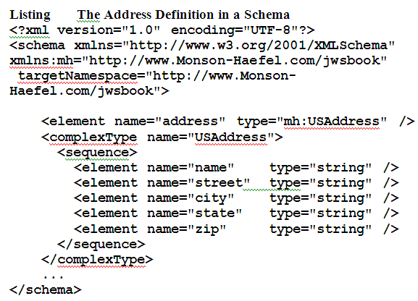
Example A

Slide 45
Notice that this Schema is basically an XML document , which is the main advantage:
It makes the development of validating parsers and other software tools easier, because the operations that manipulate schemas can be based on XML parsers, which are already widely available.
The root element of a schema document is always the schema element. Nested within the schema element are element and type declarations.
Example A declares a complex type named USAddress, and an element of that type named address.
The Schema element assigns the XML schema namespace ("http://www.w3.org/2001/XMLSchema") as the default namespace.
This namespace is the standard namespace defined by the XML schema specification—all the XML schema elements must belong to this namespace.

Slide 46
The schema element also defines the targetNamespace attribute, which declares the XML namespace of all new types explicitly created within the schema. For example, the USAddress type is automatically assigned to targetNamespace, http://www.Monson-Haefel.com/jwsbook.
The schema element also uses an XML namespace declaration to assign the prefix mh to the targetNamespace. Subsequently, newly created types in the schema can be referred to as "mh:Typename". For example, the type attribute in the element declaration in Example A refers to the USAddress as "mh:USAddress":
<element name="address" type="mh:USAddress" />
An instance document based on this schema would use the address element directly or refer to the USAddress type. When a parser that supports XML schema reads the document, it can validate the contents of the XML document against the USAddress type

Slide 47
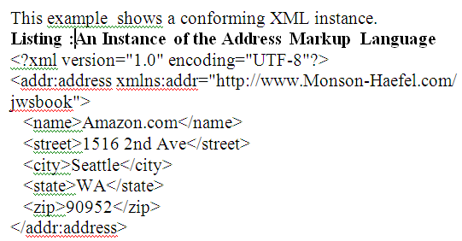
Using XML schema, we can state exactly how an instance of the address element should be organized and the types of data its elements and attributes should contain.
A simple type resembles a Java primitive type in that both are atomic; they cannot be broken down into constituent parts.
The XML schema specification defines many standard simple types, called built-in types. The built-in types are the standard building blocks of an XML schema document. They are members of the XML schema namespace, "http://www.w3.org/2001/XMLSchema".

Slide 48
Table Comparing the Use of XML Schema Simple Types and Java Primitive Types
XML Schema Built-in Simple Types (shown in bold) | Java Primitive Types (shown in bold)
<?xml version="1.0" encoding="UTF-8"?> <schema xmlns="http://www.w3.org/2001/ XMLSchema" xmlns:mh="http://www.Monson-Haefel.com/jwsbook" targetNamespace="http:// www.Monson-Haefel.com /jwsbook"> ... <complexType name="PurchaseOrder"> <sequence> <element name="accountName" type="string" /> <element name="accountNumber" type="integer" /> <element name="total" type="float" /> <!-- More stuff follows --> </sequence> </complexType> ...</schema> | package com.monsonhaefel. jwsbook ; public class PurchaseOrder { String accountName; int accountNumber; float total; // more stuff follows}

Slide 49
Complex Types
A schema may declare complex types, which define how elements that contain other elements are organized. The USAddress schema type in Example A, for example, is a complex type definition for a United States postal address. It tells us that an element based on this type will contain five other elements called name, street, city, state, and zip.
A complex type is analogous to a Java class definition with fields but no methods.
.

Slide 50
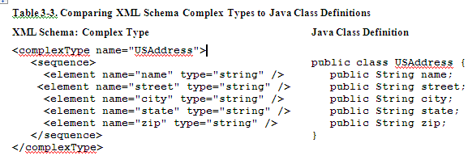
The fields in a Java class declare the names and types of variables that an instance of that class will contain. Similarly, a complex type declares the names and types of elements and attributes that an XML instance of that type may contain.
An instance of a complex type is an element in an XML document. Table 3-3 compares an XML schema type and a Java class definition for a U.S. address

Slide 51
Sequences of Elements
Most complexType declarations in schemas will contain a sequence element that lists one or more element definitions.
The element definitions tell you which elements are nested in the type, the order in which they appear, and the kind of data each element contains.
A complex type may contain a sequence of elements that are simple types or other complex types. For example, we can define an element for a purchase-order document by adding a PurchaseOrder type to the Monson-Haefel Markup Language you saw in Listing 3-2. In Listing 3-4, the new PurchaseOrder type has two nested elements, billAddress and shipAddress, both of type USAddress.

Slide 52
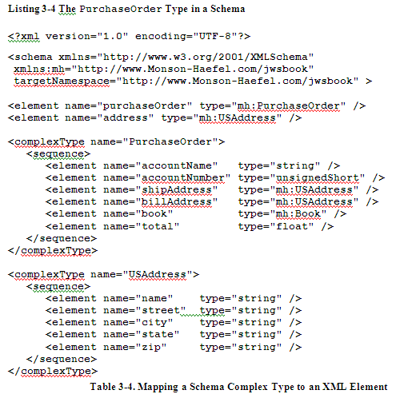

Slide 53
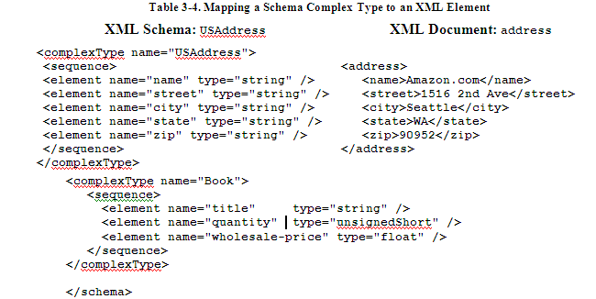

Slide 54
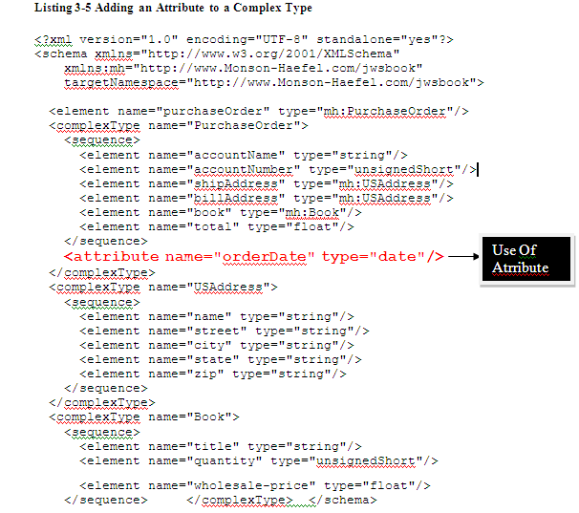
Attributes
In addition to sequences of elements, a complex type may also define its own attributes. For example, Listing 3-5 shows a new version of the PurchaseOrder type that includes the definition of an orderDate attribute.

Slide 55
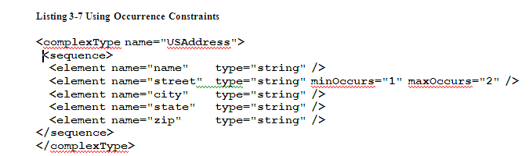
3.1.4.3 Occurrence Constraints
The multiplicity of an element, the number of times it occurs in an instance document, is controlled by occurrence constraints, which are declared by the maxOccurs and minOccurs attributes. For example, we can enhance the USAddress complex type by placing occurrence constraints on the street element as shown in Listing 3-7.
Use of minOccurs & maxoccurs

Slide 56
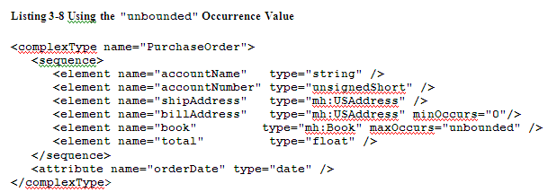
You may also define a maxOccurs value to be "unbounded" to specify that the element may occur an unlimited number of times.
Maxoccurs=unbouded
Means this element can occur for as many times as we want

Slide 57
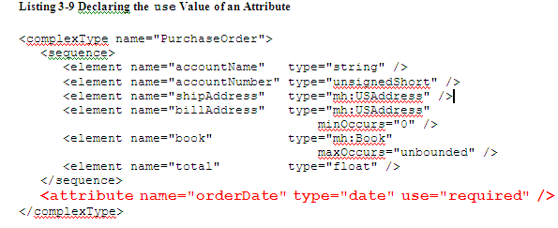
In PurchaseOrder we want to make the orderDate attribute mandatory, so Listing 3-9 sets its use occurrence constraint to "required".
Possible values of use are
1.required
2. optional
3. prohibited

Slide 58
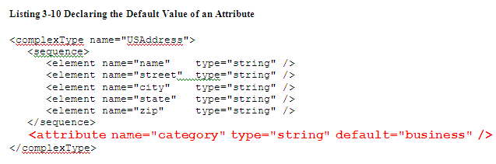
An attribute may also have a default value, to be assigned if no value is explicitly declared in the instance document. For example, the USAddress type may include an attribute called genre that can have the value "business", "private", or "government". Almost all addresses used by Monson-Haefel Books are business addresses, so we set the default for the genre attribute to "business" in Listing 3-10.

Slide 59
The default attribute can be used only when the use attribute is "optional" (recall that "optional" is the default value for the use attribute).
An attribute may also be declared fixed: A fixed value is assigned to the attribute no matter what value appears in the XML instance document.

Slide 60
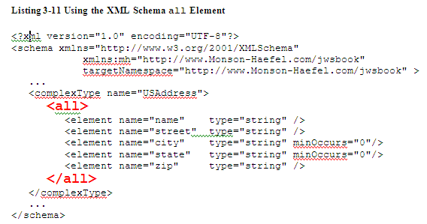
3.1.4.4 The all Element
Most of the time you'll base complex types on sequence elements, but occasionally you may want to use the all element. Unlike sequence, which defines the exact order of child elements, the XML schema all element allows the elements in it to appear in any order. Each element in an all group may occur once or not at all; no other multiplicity is allowed. In other words, minOccurs is always "0" and maxOccurs is always "1".

Slide 61
PROCESSING XML DOCUMENTS:
A software application that reads and manipulates XML documents will use an XML parser. In general, parsers read a stream of data (usually a file or network stream) and break it down into functional units that can then be processed by a software application.
An XML parser can read an XML document and parse its contents according to the XML syntax. Parsers usually provide a programming API that allows developers to access elements, attributes, text, and other constructs in XML documents.
There are basically two standard kinds of XML parser APIs: SAX and DOM.

Slide 62
SAX (Simple API for XML Parsing)
First standard XML parser API and is very popular, latest version is SAX2.
SAX2 parsers are available in many programming languages including Java.
SAX2 is based on an event model. As the SAX2 parser reads an XML document, starting at the beginning, it fires off events every time it encounters a new element, attribute, piece of text, or other component.
SAX2 parsers are generally very fast because they read an XML document sequentially and report on the markup as it's encountered.

Slide 63
DOM (Document Object Model)
Developed after SAX2 and maintained by the W3C.
DOM 2 presents the programmer with a generic, object-oriented model of an XML document.
Elements, attributes, and text values are represented as objects organized into a hierarchical tree structure that reflects the hierarchy of the XML document being processed.

Slide 64
1. Write an XML Schema for the following XML Document
<?xml version=“1.0” ?>
<movies> <movie genre=“crime"> <title lang="en">The Godfather</title> <year>1972</year> <rating>9.2</rating> </movie> <movie genre=“horror"> <title lang="en">The conjuring</title> <year>2013</year> <rating>7.5</rating> </movie> <movie genre=“adventure"> <title lang="en">Everest</title> <year>2015</year> <rating>7.4</rating> </movie> </movies>

Slide 65
2. Write an XML instance for following schema and then parse that document in Java using either DOM or SAX API.
<?xml version=“1.0” ?>
<xs:schema xmlns:xs=“http://www.w3.org/2001/XMLSchema”>
<xs:element name="person“ type="persontype"/>
<xs:complexType name="persontype"> <xs:sequence> <xs:element name="firstname“ type="xs:string"/> <xs:element name="lastname" type="xs:string"/> <xs:element name=“date_of_birth” type=“date”/>
</xs:sequence> </xs:complexType>
<xs:complexType name=“date”>
<xs:sequence>
<xs:element name=“day” type=“xs:integer”/>
<xs:element name=“month” type=“xs:integer”/>
<xs:element name=“year” type=“xs:integer”/>
</xs:sequence>
</xs:complexType>
</xs:schema>

